Slide 1
Communicating Models Explaining complex systems to diverse audience

Slide 2
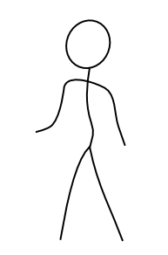
?@#!!
This model is a Black Box
All models are wrong,
but some are useful

Slide 3
Communicating Models
Two levels required
Technical documentation
Each stage of model development should be thoroughly documented, including equations and assumptions
Communicating to non-technical audiences
How do we communicate to non-modelers, stakeholders, general public, etc…

Slide 4
Developing a good modeling practice is essential for communication
Biggest issues: readability and repeatability. Can the model be recreated?
What is missing is a modeling practice that details the trial-and-error process.
ODD protocol is a modeler’s model description. It doesn’t tell the story unless you’re familiar with the protocol.

Slide 5
Establishing a modeling practice
Poor track record of documented modeling practice created black box syndrome
ad hoc model design,
Poor evaluation and testing
Unknown sensitivities
Lack of clear documentation for parameters
Improper application (documentation should include how model should be applied)
Peer reviewed manuscripts don’t cut it when communicating models—they don’t relay the process and aren’t transparent to non-scientists.

Slide 6
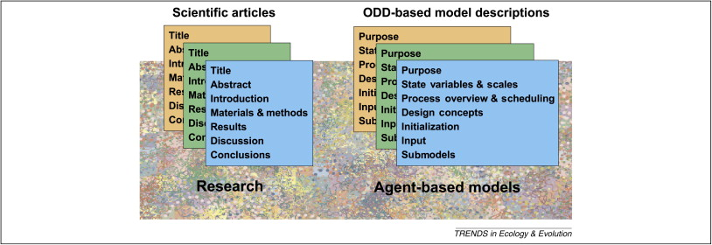
TRACE
Models don’t fit into traditional structure because they are both a method and result
Transparent and comprehensive ecological modeling (TRACE) documentation attempts to set a standard for model communication and defensibility
Notes:
General idea is to create a similar paradigm for modeling studies like there is for scientific studies.

Slide 7
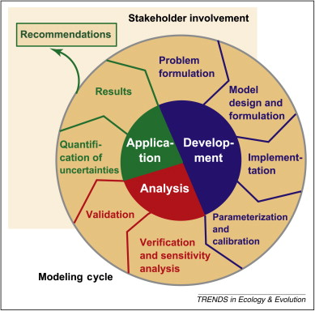
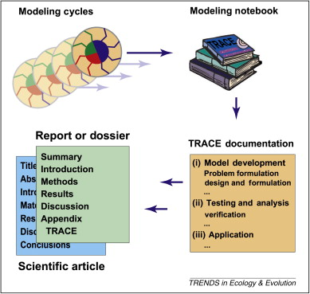
Modeling notebooks
Document the process like lab studies
Notes:
Need to keep track of functions implemented, what tests were run, parameters used, etc.
We generally don’t do this.

Slide 8
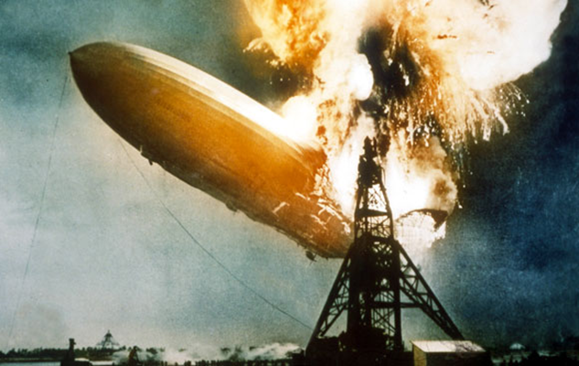
Model Communication can be a disaster!
Most ignored aspect of modeling
Confusion over the meaning of “model”
Preexisting notions prevent audience from understanding objective
Very rarely do we
Analyze audience
Anticipate potential obstacles
Hall et al. 2014
Notes:
It was a disaster.
First, there was confusion over the meaning of the Term Model;
NPS wanted a simple conceptual model and the participants could not understand why;
Secondly, each had a pre-existing notion of what type of model was being sought after and what a constituted a good model
This prevented the group from moving towards the objective
This group of very accomplished people got frustrated; It cost us a great deal of time
From this disaster …we spent a lot of time thinking about what went wrong.
We turned to the technical communication literature
Realized: we should have considered our audience more carefully; Audience analysis would have allow us to anticipate potential obstacles to communication…
From the Technical Communication research and literature, we learned there were 3 common obstacles to commutating complex material like models

Slide 9
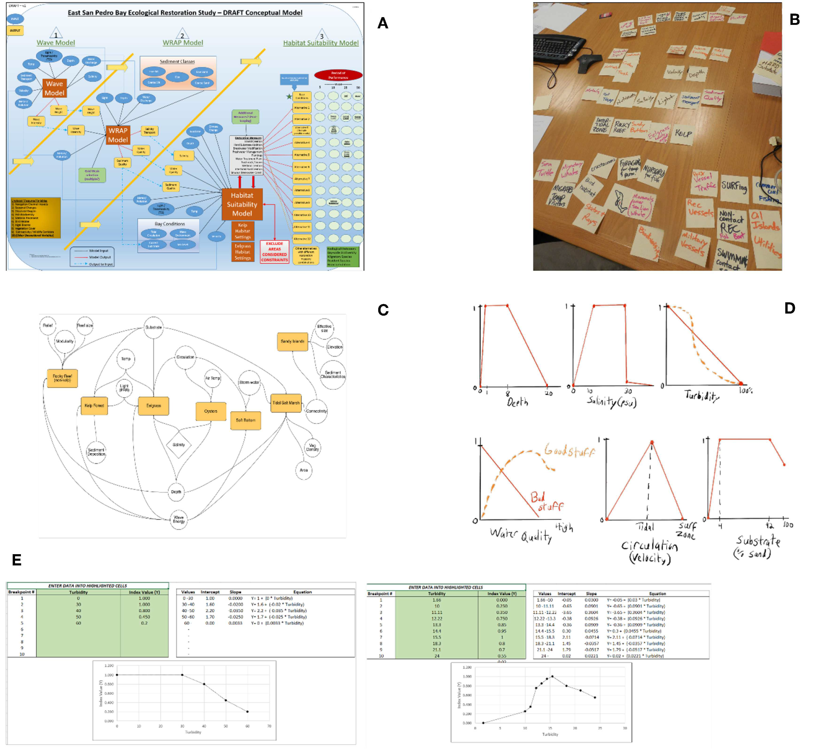
Stakeholder engagement Case study: East San Pedro Bay
Development shouldn’t be limited to modelers only
Stakeholders provide valuable input, and tend to have a lot of power within the community
Engage early and often.
If possible have them assist with model development
Herman et al., 2019

Slide 10

Three Common Obstacles in Communicating Models
1. Audience fails to understand meaning & use of a key concept or term
2. Audience struggles to represent mentally some phenomenon, structure, or process
3. Audience may have a preexisting understanding preventing them from believing (therefore understanding) the model
Notes:
1.
2. Education psychologists have difficulty forming a mental picture of a complicated system.
People have trouble envisioning systems with many variables, feedback loops, and extended time frames
3.
For each obstacle, there is a way of overcoming

Slide 11
1. Audience fails to understand meaning of a key concept
Elucidating Explanation:
Lists a concept’s critical features
Provide an array of varied examples & nonexamples
Provides opportunities to practice distinguishing examples from nonexamples by looking for critical features
Notes:
Linguistics and science education research show people have difficulty distinguishing a concept’s essential features—elements that are always present—from its nonessential features, elements that are typically coincident but not necessarily so.
Provide an Elucidating Explanation
Lists a concept’s critical (essential vs. nonessential) features
An array of varied examples & nonexamples
(non examples are instances likely to be mistaken for examples)
Provides opportunities to practice distinguishing examples from nonexamples by looking for critical features

Slide 12
2. Audience struggles to represent mentally some phenomenon, structure, or process
A General Impression of the System
Develop a summary image identifying critical components
Structure-suggesting titles & organizing analogies
Strong main points & connections
Easily discernible points with clear connections between them that create a narrative form
Clear conceptual models can really help with this
Notes:
2. Audience struggles to represent mentally some phenomenon, structure, or process
Model communicators can help audiences overcome this by providing a general impression of the system so they may grasp the system's component parts & connective processes
Develop a summary image identifying critical components, processes, and outputs of the system.
As with a sketch, the aim is to capture the structure & general impression of the system.
Effective strategies for verbally explaining the model include:
(a) structure-suggesting titles such as “Spaceship Earth” or “Five Areas of Study” and
(b) organizing analogies such as “your brain works like a computer” or “a wetland is like a filter”
studies show that the best explanations stay with one analogy rather than mixing different analogies
Use: Strong main points & connections
Use easily discernible points with clear connections between them that create a narrative form: Good transitional phrases are key

Slide 13
3. Audience’s preexisting notions prevent understanding
Transformative Explanation
States existing "lay" or "implicit" description of the system
Acknowledge the apparent plausibility
Using examples familiar to the audience, point out where existing description falls short
Present an alternative explanation
Demonstrate how alternative more effectively represents the system
Notes:
People spend lifetimes building intuitive understandings of how the world works. When a model clashes with audience members' beliefs, logics, or values, that dissonance disrupts their willingness and ability to accept the model
Use a transformative explanation that first (a) acknowledges the audiences' pre- existing notions of the system; state the existing "lay" or "implicit" description of the system, (or asks questions to elicit one)
(b) discusses its plausibility, perhaps by including supporting observations.
(c) points out, using examples familiar to the audience, where the existing description falls short,
(d) presents the alternative explanation, and
(e) demonstrates how it more effectively represents the system

Slide 14
Model Communication Agent-based case study: Oyster modeling in Chesapeake Bay
Oyster abundance at all time low
Federal and state agencies disagree on how to best manage species (fishery vs. environmental benefits)
Developed an integrated hydrodynamic-ecological model to address management questions
Multi-disciplinary team developed hydrodynamic, particle tracking, and agent-based models
Notes:
Using the lessons learned from our disaster model communication experience and subsequent research
I want to discuss how I applied the technical communication lessons to a case study with an agent based model

Slide 15
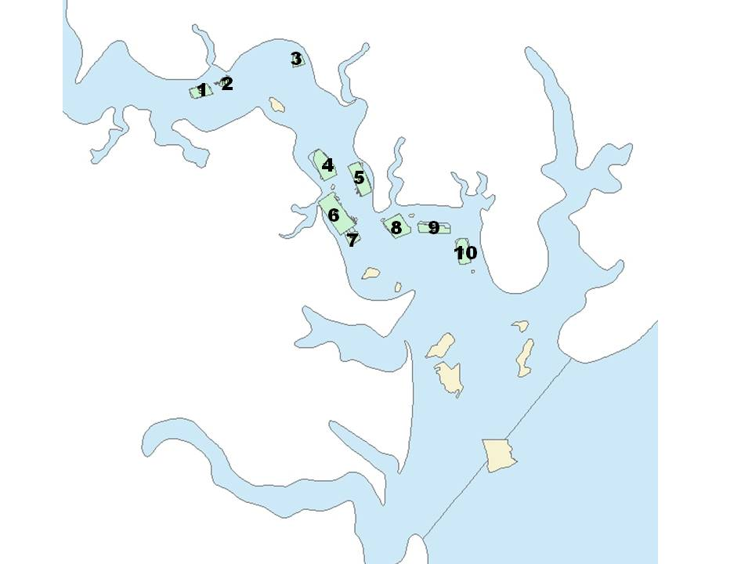
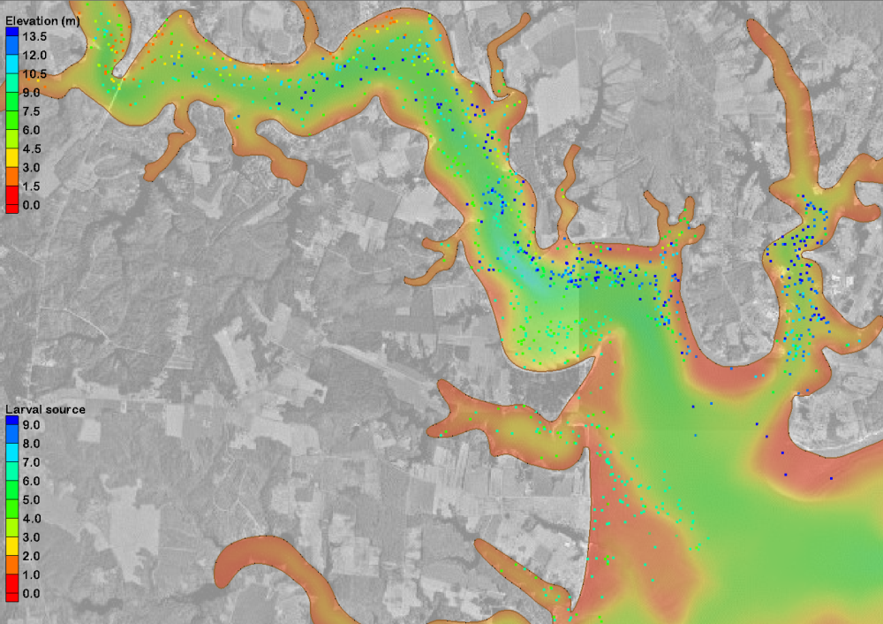
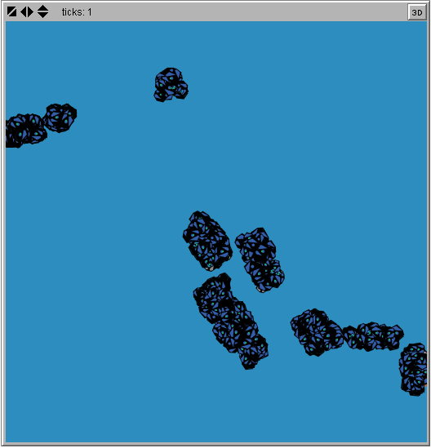
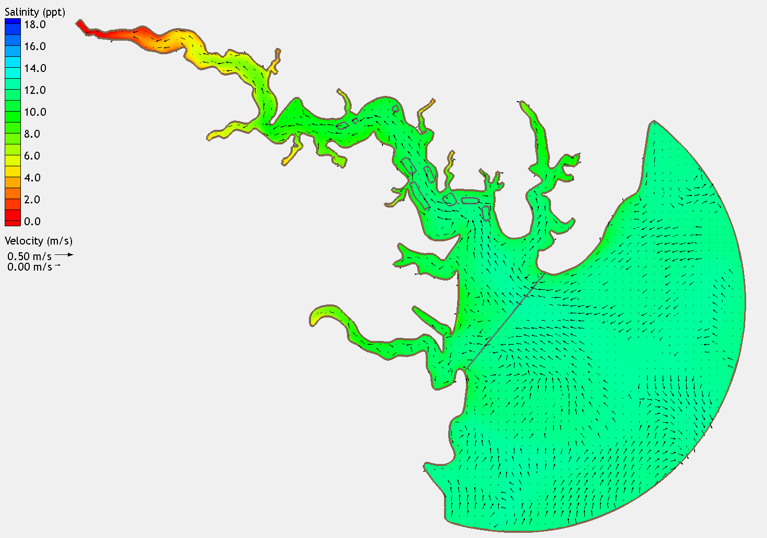
Communication challenge How to make this understandable & meaningful?
Great Wicomico
River
Oyster reefs
Ingram
Bay
Chesapeake
Bay
Kjelland et al., 2015

Slide 16
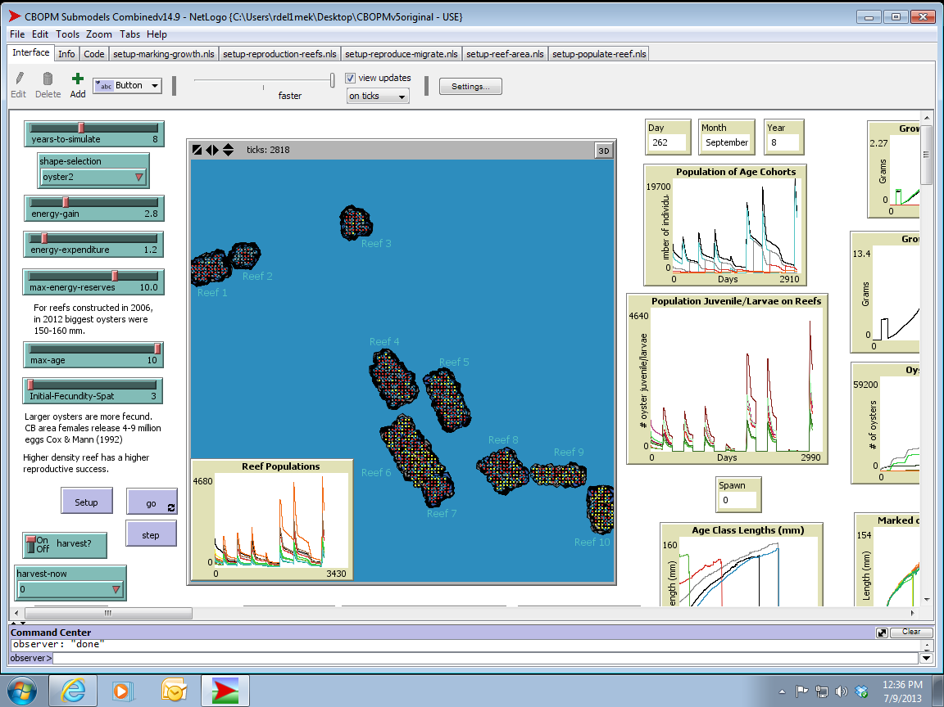

Slide 17
We decided on a mediated-modeling approach (Herman et al., 2019)
Federal & state stakeholders
Planners, project managers, fisheries managers, oyster biologists
No engineers or modelers in stakeholder group, but they had general understanding of models
Audience Analysis: Series of meetings prior to, during, and after model development
Preliminary meeting: discussion of modeling approach
Identified background knowledge and experience of stakeholders
Second meeting: we convened with stakeholders to evaluate model and develop scenarios

Slide 18
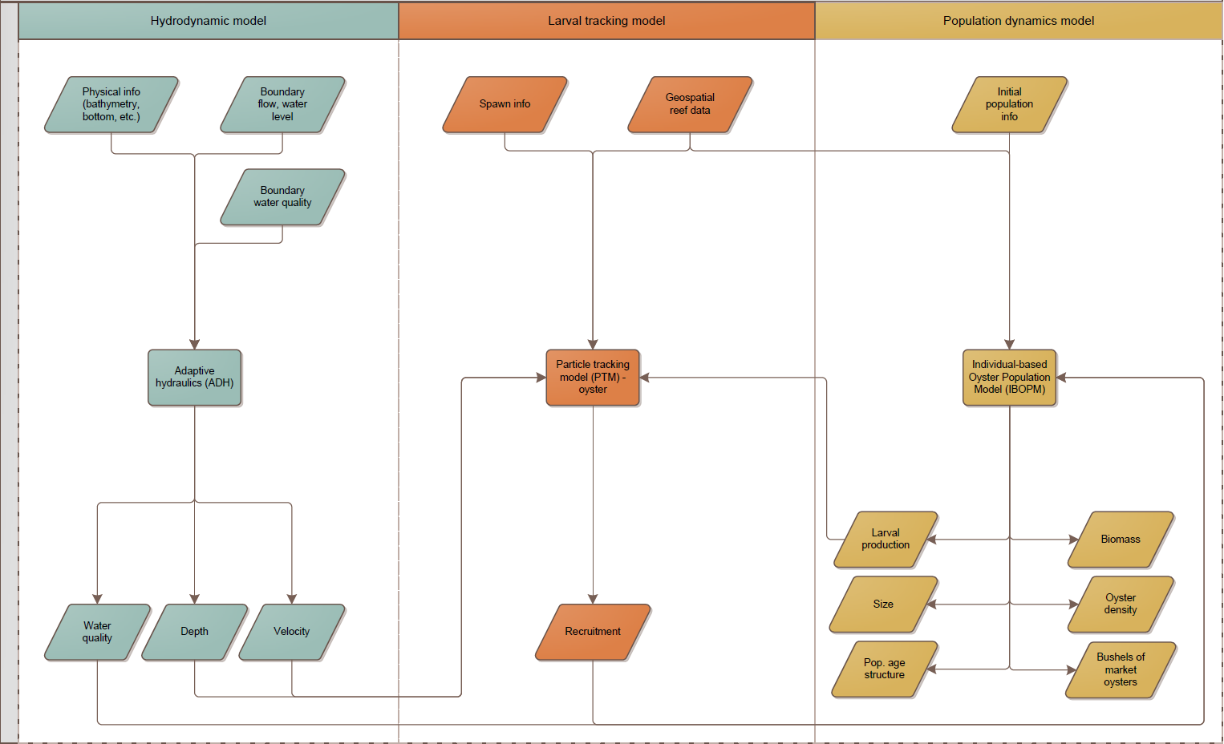
Obstacle 2: Understanding big picture
Inputs
Models
Linkages
Outputs
Notes:
Based on our Audience Analysis (conversations with stakeholders)
We Anticipated Obstacle 2: This Audience would most likely struggle to represent mentally the overall structure of the system with our interacting models
Although we could have spoken for days about the months of modeling work
We decided to commit to Providing a general impression of the system
Developed interactive flow charts. Spoke in generalities unless questioned about specifics. Had all parameter tables and equations available. More focus on oyster biology

Slide 19
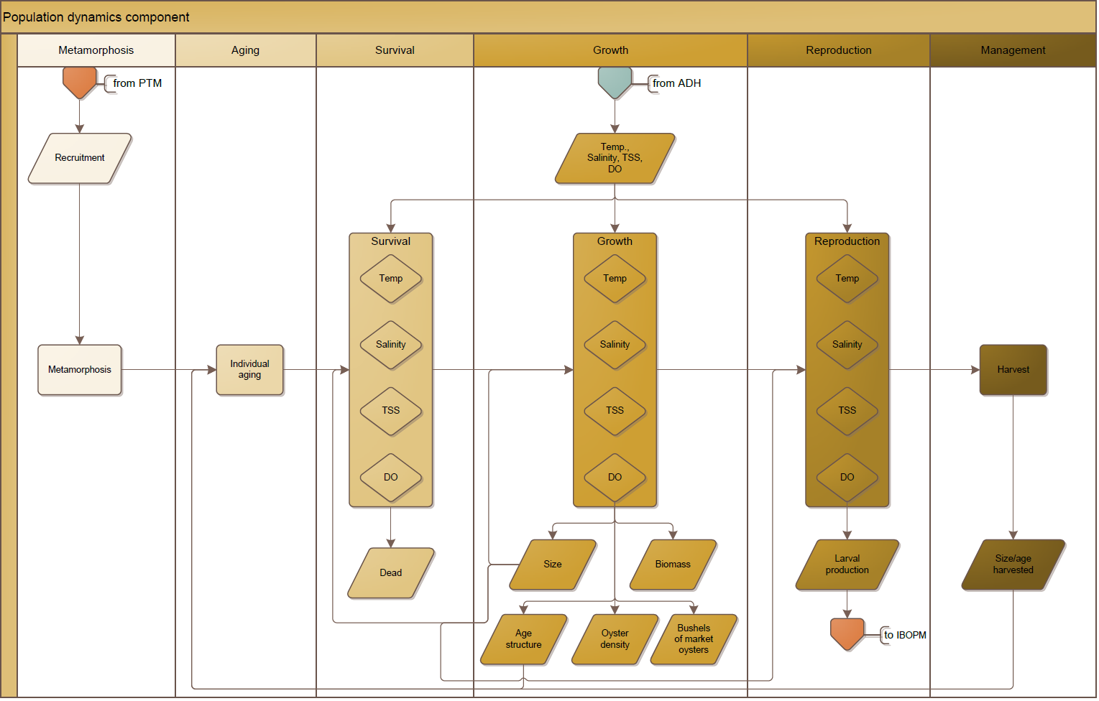
Drilling down to points of interest
Population Dynamics Submodel
Input
Processes
Outputs
Notes:
Developed a summary image
Focused on only the critical components

Slide 20
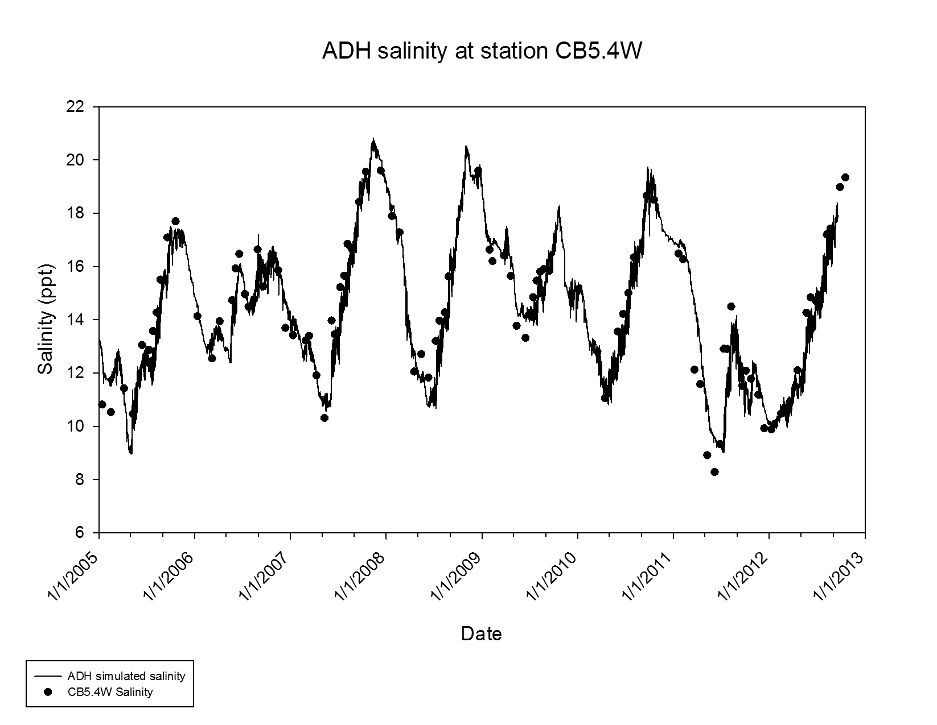
Obstacle 2 confirmed
Audience was interested in big picture of oyster dynamics and not underlying hydrodynamic & particle tracking models
For example:
Notes:
Based on the feedback during our presentation it was apparent that the audience was interested in big picture of oyster dynamics and not underlying hydrodynamic & particle tracking models

Slide 21
Additional Model Communication Pitfalls Observed
Each team member wants to talk about how cool their stuff is
Audience analysis defines interests (i.e., what to talk about, what to omit)
Notes:
After meeting with stakeholders and getting to know what their interests were and anticipating obstacles, we also discovered a couple of other potential pitfalls.

Slide 22
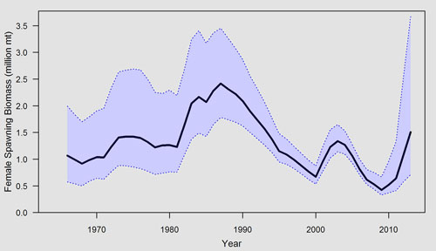
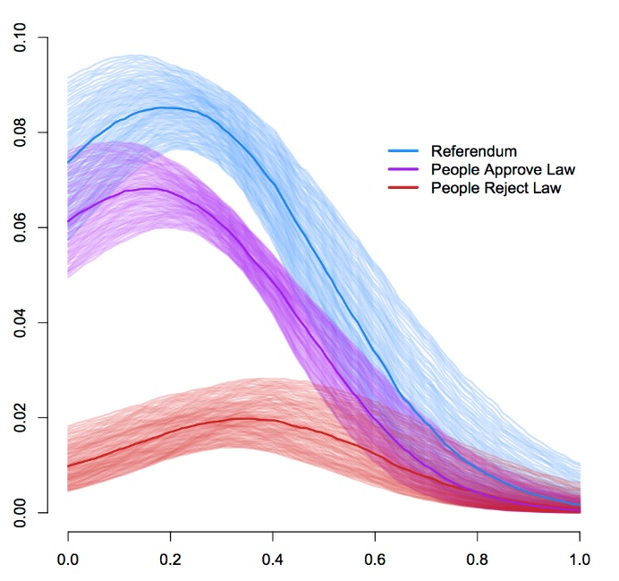
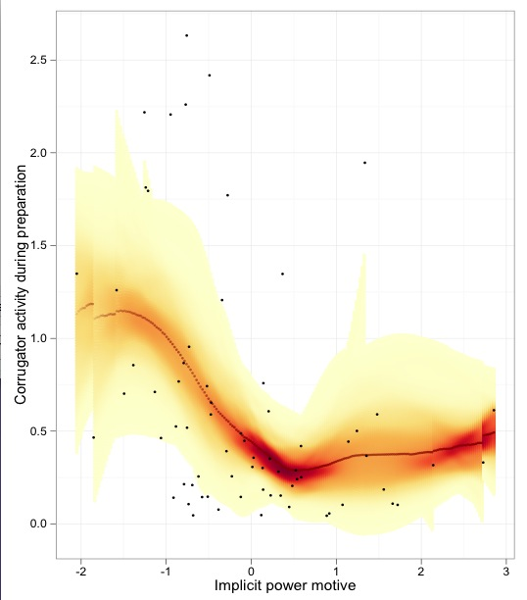
Potential Pitfalls
Discussing, rather than just documenting, uncertainty is crucial
Without describing limitations, it hurts modeler’s credibility
Notes:
After meeting with stakeholders and getting to know what their interests were and anticipating obstacles, we also discovered a couple of other potential pitfalls.
Defies commonsense. Commonsense tells us to hide our errors. Discussing uncertainty, rather than just documenting it actually improved the audience’s receptivity of this model…

Slide 23
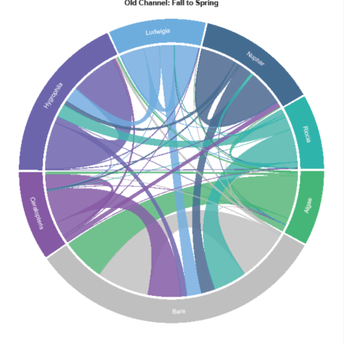
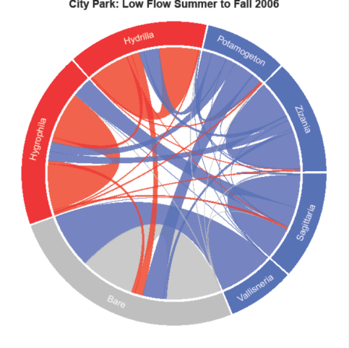
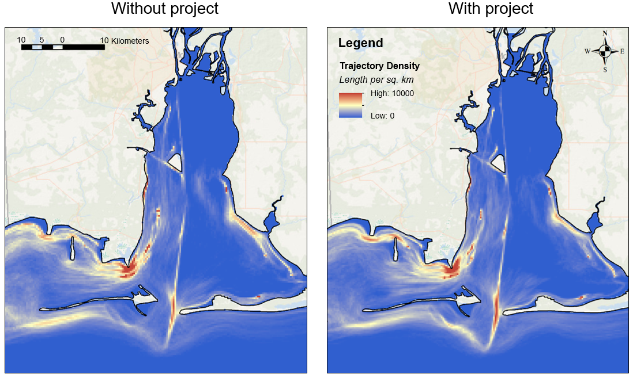
Novel Visualizations
Visual exploration takes advantage of the capacity of the human eye to rapidly detect and patterns. Use them to tell your story
Interesting to certain audiences
Colors draw eye and audience tends to pay attention

Slide 24
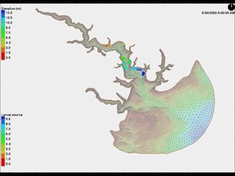
3
2
1
4
5
6
8
9
7
10
Connectivity in oyster reefs

Slide 25

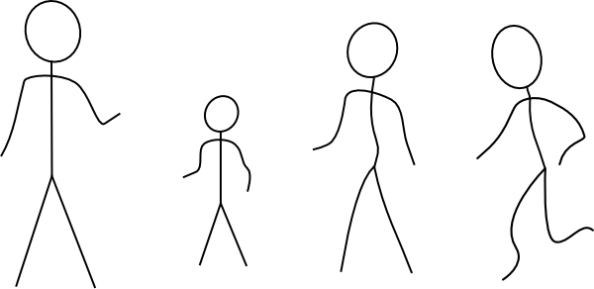


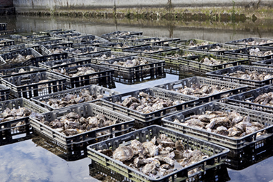

Model
Hmm?
?@#!!
$$≅$$

